Slide 1
Sales Prediction Model Selection
A Data Science Approach
January 2022
Produced by George Lee

Slide 2
Overview
In an effort to predict sales for products in our store outlets, two machine learning models were analyzed to determine which model would best project future sales based on available data on the products and outlets. Machine learning models will analyze features data to create a model to predict future sales which will be measured for degree of accuracy.
A brief overview of the approach and model vetting criteria:
Features and sales data is segmented in to model training and model testing data groups.
Model built on training data then deployed against testing data to identify the error between actual and model predictions.
Model Vetting Methods:
Coefficient of Determination R² measures the percentage of variation between predicted and actual sales that can be explained by the features in our model.
Root Mean Square Error measures the average variance between predicted and actual sales.

Slide 3
Model Prediction Performance
Linear Regression
Coefficient of Determination
Training R²: 56.0%
Testing R²: 56.6%
Root Mean Square Error (RMSE)
Training RMSE: 1140.3
Testing RMSE: 1094.7
Decision Tree
Coefficient of Determination
Training R²: 100.0%
Testing R²: 13.6%
Root Mean Square Error (RMSE)
Training RMSE: 0.0
Testing RMSE: 1543.5

Slide 4
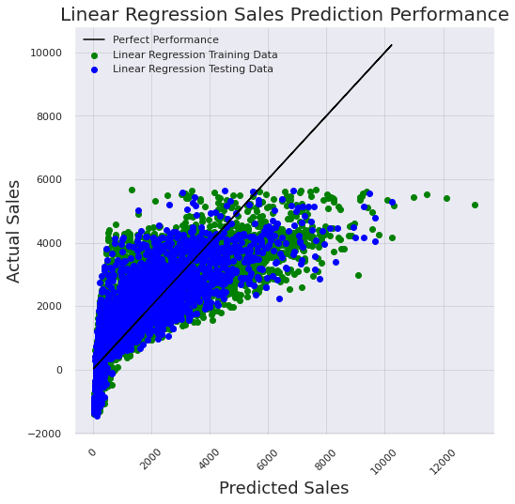
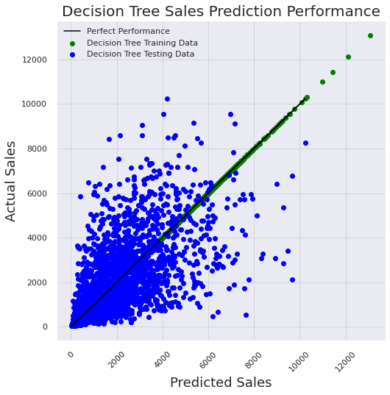
Visualizing Model Performance
Linear Regression
Decision Tree

Slide 5
Conclusion
Linear Regression Modeling
Consistent
Can be more accurate
Decision Tree Modeling
High variance in performance
Less accurate than linear regression model

